Slide 1
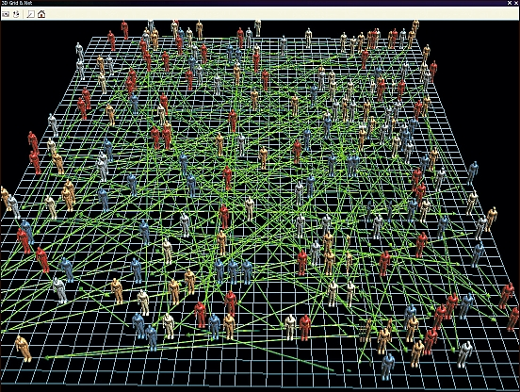
Agent-based models

Slide 2
What is an agent-based model?
Notes:
Task: Set up a spare room with tables as a bit of a maze – make sure we can move forward and right to actually get to a ‘goal’ in the far corner.
Blindfold a volunteer – and get them to the goal – how were instructions given?
Do again.
Do final time, but this time, only commands are from before the start

Slide 3
What is an agent-based model?
Agent - Normally relates to an individual
Also known as individual-based models
Agent moves through an environment
May modify that environment
May modify its internal ‘settings’
Limited knowledge of the environment
Notes:
Task 2. Hand out animals – ask people to think of what they would do in the situations on the next slide
Basking shark
Lion
Magpie
Snail
Great white shark
Haddock
Domestic dog
Domestic cat
Horse
Zebra
Clownfish
Sheep
Robin
Hedgehog
Sloth
Honey bee
Owl
Neanderthal
Fiddler crab
Butterfly
Wasp
Squirrel
Brown bear

Slide 4
What does your animal do in the following circumstances?
Encounters another smaller agent
Encounters another bigger agent
Encounters another agent of the same size
Is hungry
Weather gets cold
Passes a location another individual of the same species has been
Passes a location another individual of a different species has been
Is scared

Slide 5
The need for decisions
‘Encounters another species of the same size’
Are they the same species?
Are they of the same sex?
These sort of things wold be good to know in order for the agent to behave correctly

Slide 6
The need for decisions
‘Is hungry’
Eat?
Is there food?
No.
Move
Is there food now?
Yes.
Eat

Slide 7
A good set of assumptions for ABMs
But – not essential – if the assumptions don’t fit the modelled organism, then they can be changed
Has some sort of internal regulation (energy, temperature, time available etc)
Has knowledge of the local environment (i.e. knows what is around it), based on ‘sense’
Is able to make decisions which may depend on local knowledge and internal variables

Slide 8
Kinesis in woodlice

Slide 9
Kinesis in woodlice
Internal variable = water level – 100 point scale – and loses water at 5 units each timestep in dry conditions and gains at 1 nit per timestep in wet conditions
External variable = desiccation – either dry or wet
Behaviour – angle it can turn at – either high or low
Notes:
Task – make a flow chart of kinesis in woodlice, indicating decisions which need to be made

Slide 10
Foraging in basking sharks
Feeding rate
(depends on plankton)
High
Low
Reduce plankton level in patch
Reduce plankton level in patch
Move in tortuous pattern (turn tightly)
Move in straight line

Slide 11
Environments
The flow chart should be identical for woodlice and basking sharks
Except, basking sharks eat food, and therefore modify their environment
And the environment may not be static – as plankton can grow

Slide 12
Typically in ABMs
Agents move (but not always)
Agents interact with their environment
Effecting the internal state of the agent
And effecting the environment
Agents may also interact with each other
Eat
Run away
Mate
https://www.youtube.com/watch?v=dgzLocTaSvM

Slide 13
Interactions are simple
Eat = increase agent’s energy and decrease food in immediate area
But this can create complex or emergent patterns when there are lots of agents

Slide 14
Part 2 – programming all of this
We’ll start with python – it is harder than netlogo, but a little more intuitive

Slide 15
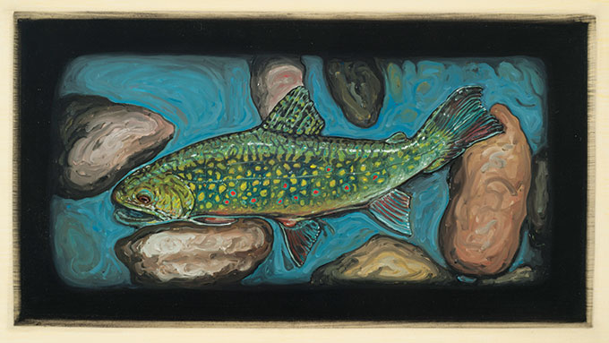
Biological Realism in Models

Slide 16
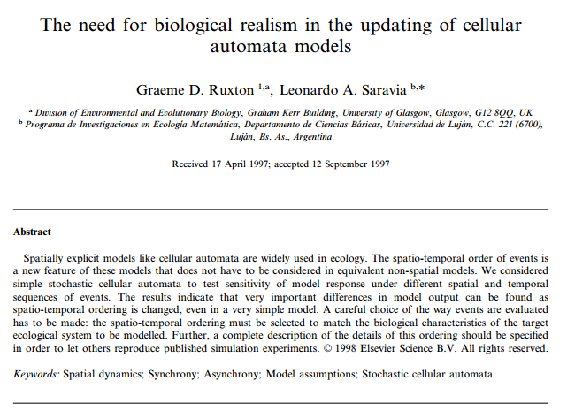

Slide 17
Examples
Ecological niche as a five bit array
00011
Ensuring perception of fear is included in prey models
Individual based model of sandeels

Slide 18

Models must be simplifications of real life

Slide 19
Things to consider
What are you trying to find out?
If exact position is important, then it makes sense to model movement as well as possible
If energy is important, then you need to know cost of movement, values in food, trophic efficiency etc
Values for disturbance
Ability to navigate
Amount of ‘local information’

Slide 20
Some useful things
Movement
Generally assumed that most mobile organisms move of a given heading and change this heading with an angle from a normal distribution – mean of 0, variance will depend how directional the movement is.

Slide 21
Some useful things
Movement
numpy.normal.random(mean, SD, number)
Set an angle, then add/subtract the random change in heading
Change the angle to one of eight headings
Add to the new heading on the next step

Slide 22
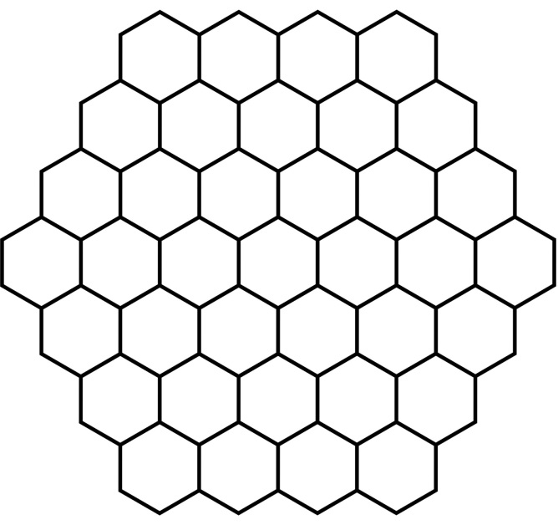
Diagonals, hexagons and energy
Movement of agents
We’ve often considered 1 of 8 directions
But the diagonal distance is further than non diagonals
Hexagonal grids have been used in the past – but don’t correspond to nice data structures
Could define energy of movement differently for diagonals
Or assume it will all average out in the end

Slide 23
When to stop moving
Snails would sometimes stop in crevices and sometimes not. More likely to if the rock became drier (i.e. later in the model)

Slide 24
When to stop moving
Snails would sometimes stop in crevices and sometimes not. More likely to if the rock became drier (i.e. later in the model)
prob = ((time/100)^2)/100
# from a regression or similar…
if numpy.random.random > prob
Keep moving
Else
Stop

Slide 25
Agents and individuals
Often the same thing
Normal to model all animals
But does not have to be
Sardine run
Model whole population as one agent, or a few agents
But depends on the question – in terms of a general food resource – or in terms of ability to avoid prey?

Slide 26
Emergence and self-organisation
Common outcome of ABMs, especially with social insect models
Involve simple rules at the individual level
Follow strongest pheromone trail
Stay same distance from close neighbour
Make complex patterns at population level
Solve optimisation tasks
Create dense fish shoals

Slide 27
Parameters
Parameters can be difficult to find for agent-based models
Partly because basic biology and behaviour are rarely published
Methods for finding parameters
Observations
Experiments
‘Optimisation’ such as ABM

Slide 28
Sensitivity Analysis
One way to find out how important a parameter is
Systematically adjust parameters (~ 10% is standard)
Look at the overall effects of the model
Those which have the biggest effect are the most important to know accurately

